Slide 1
Final Project PBKK
Bromo Adventure 2022
PBKK B - Kelompok 1

Slide 2
Kelompok 1
Florentino Benedictus 5025201222
Fian Awamiry Maulana 5025201035
Erza Janitradevi Nadine 05111940000153

Slide 3
01
TAMPILAN WEBSITE

Slide 4
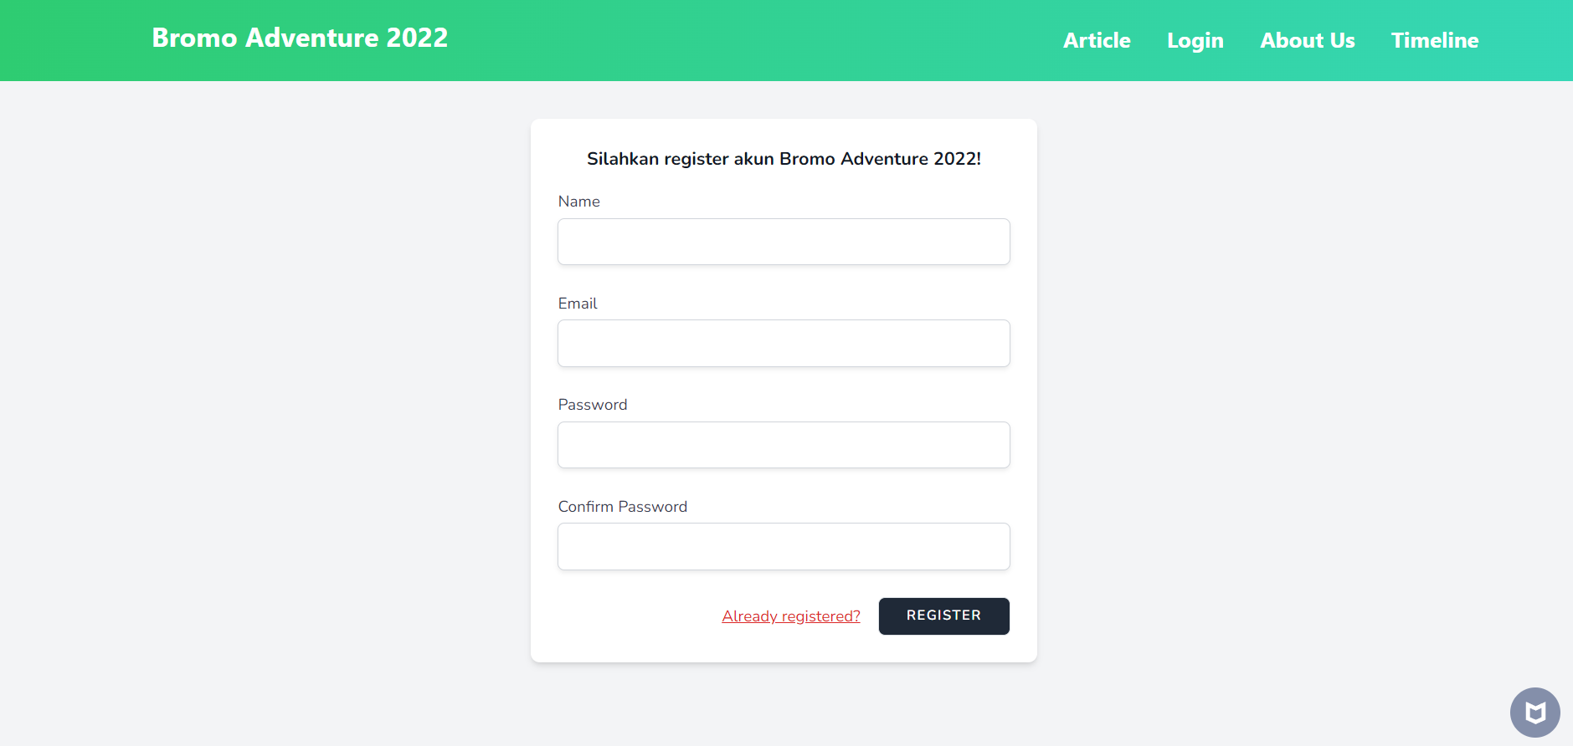
REGISTER

Slide 5
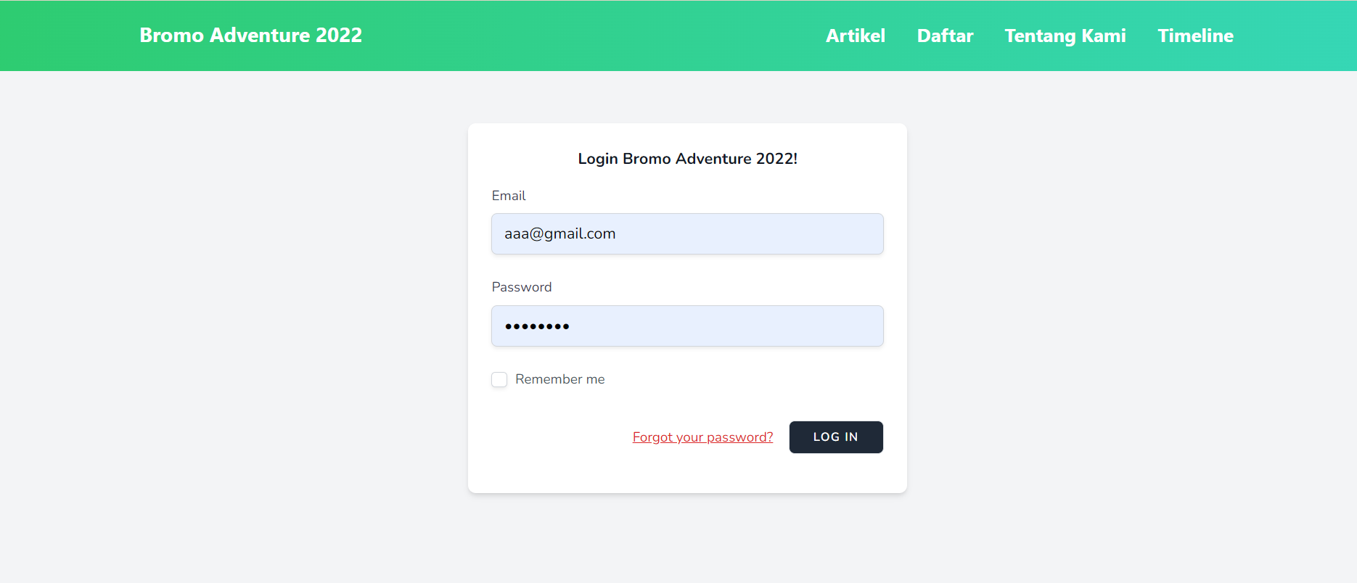
LOGIN

Slide 6
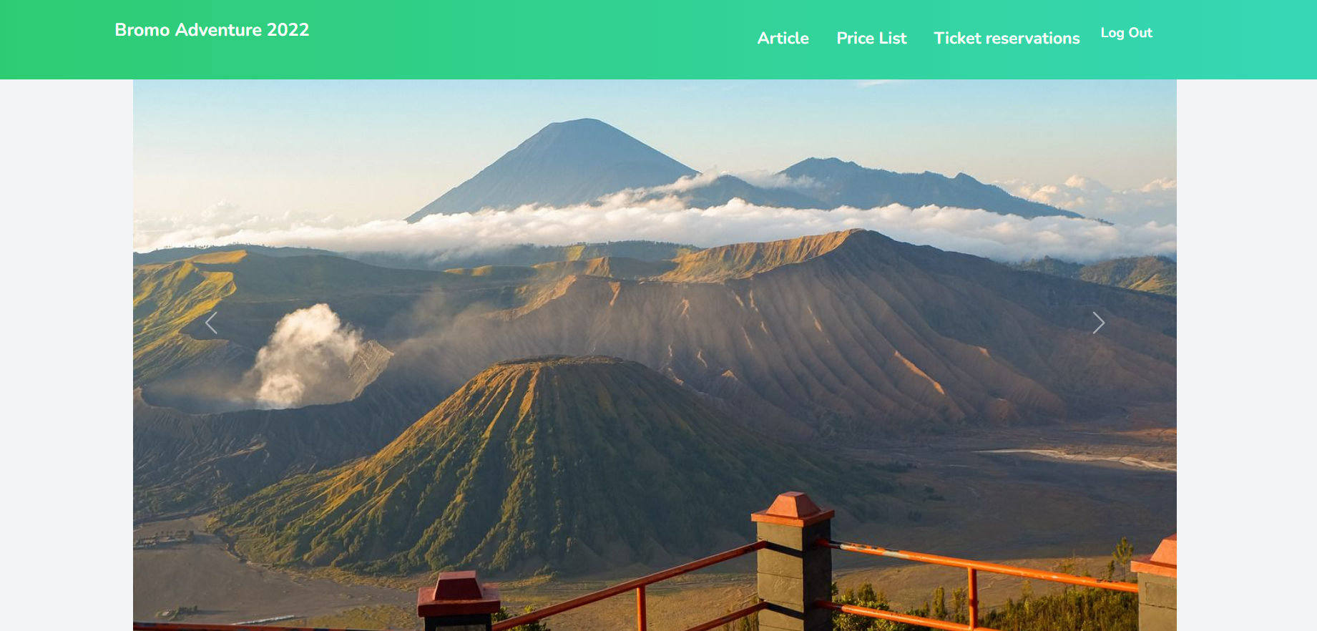
DASHBOARD

Slide 7
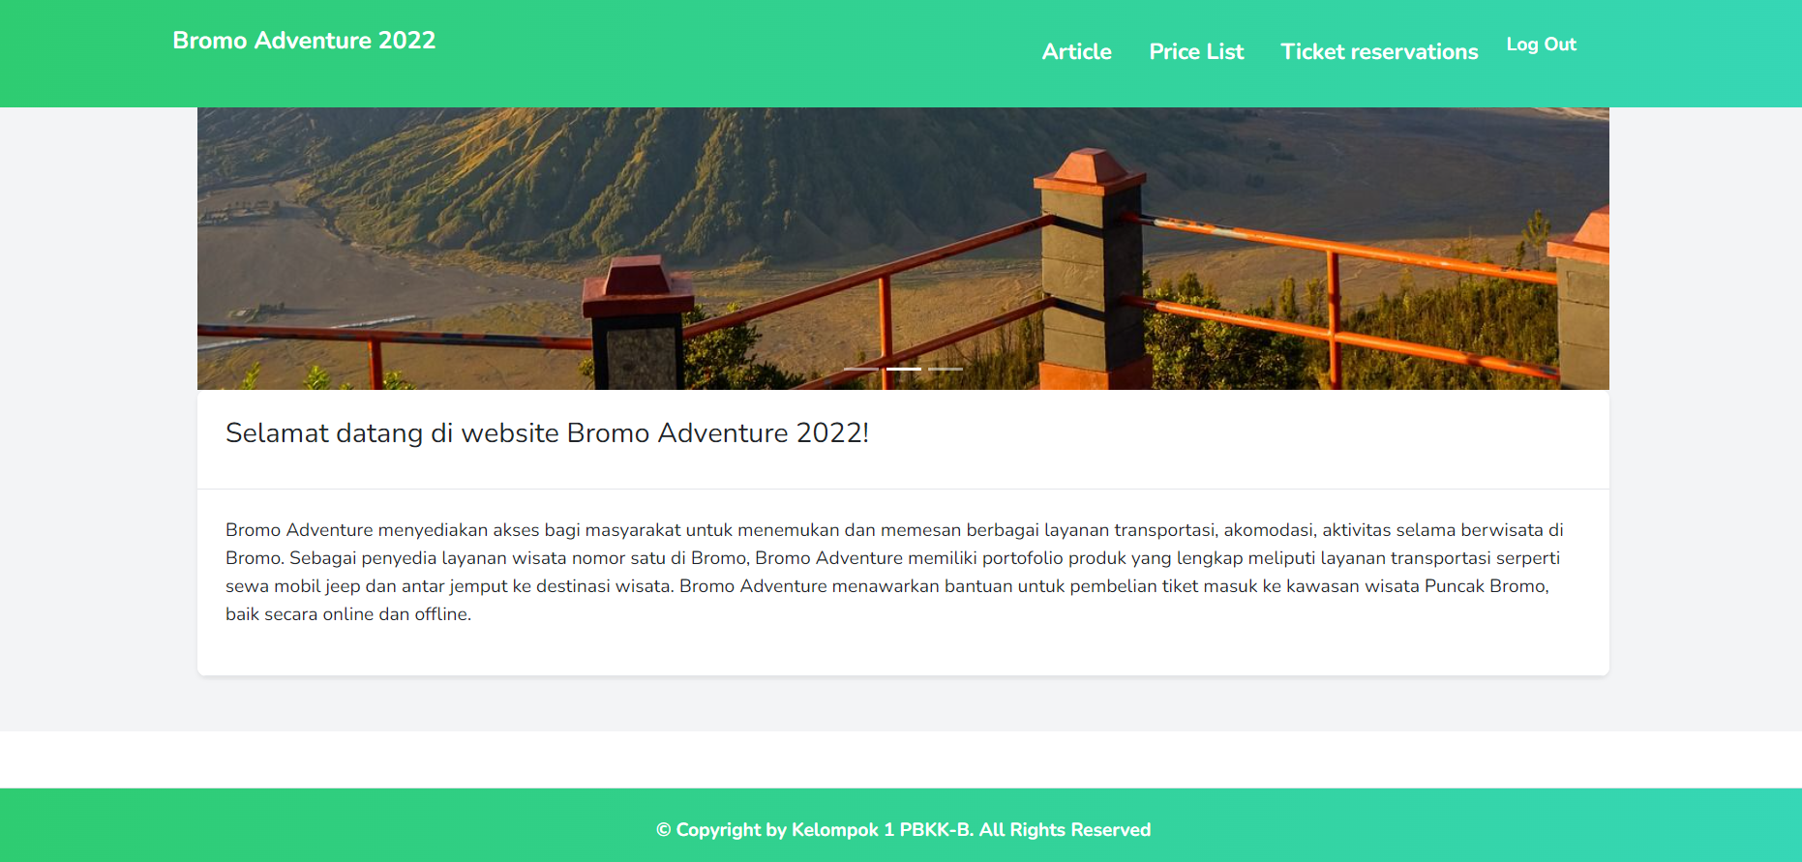
DASHBOARD

Slide 8
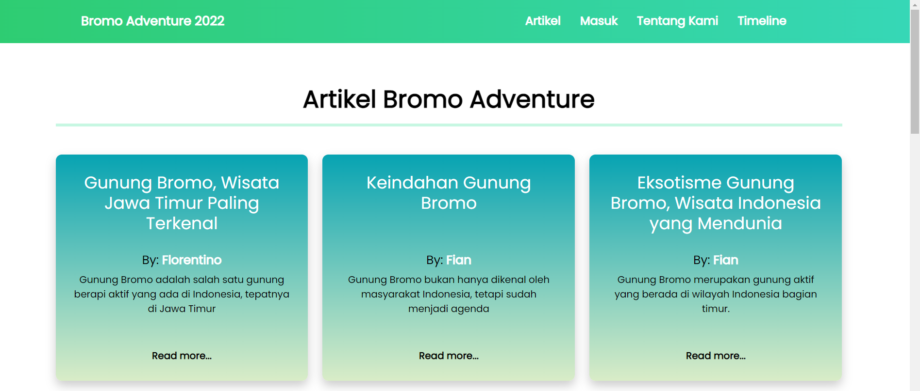
ARTIKEL

Slide 9
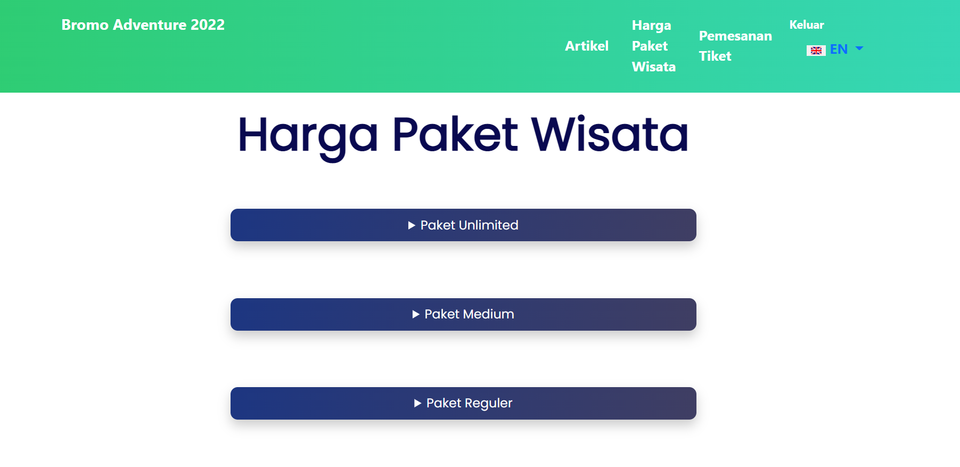
PRICE LIST

Slide 10
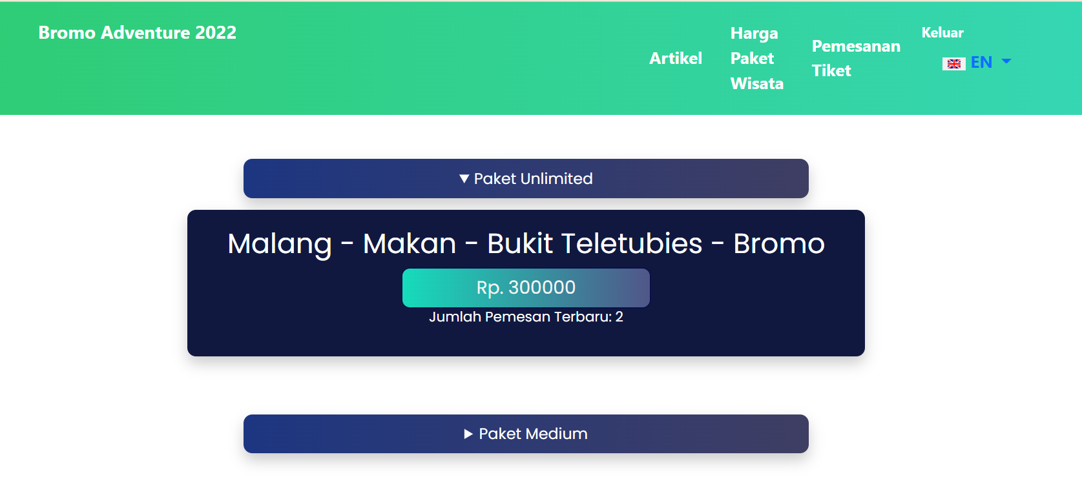
Penggunaan Cache pada Price List

Slide 11
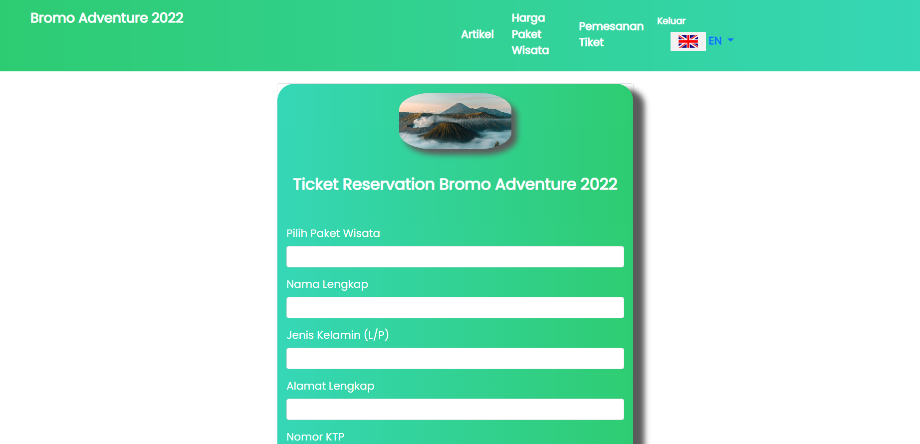
TICKET RESERVATIONS

Slide 12
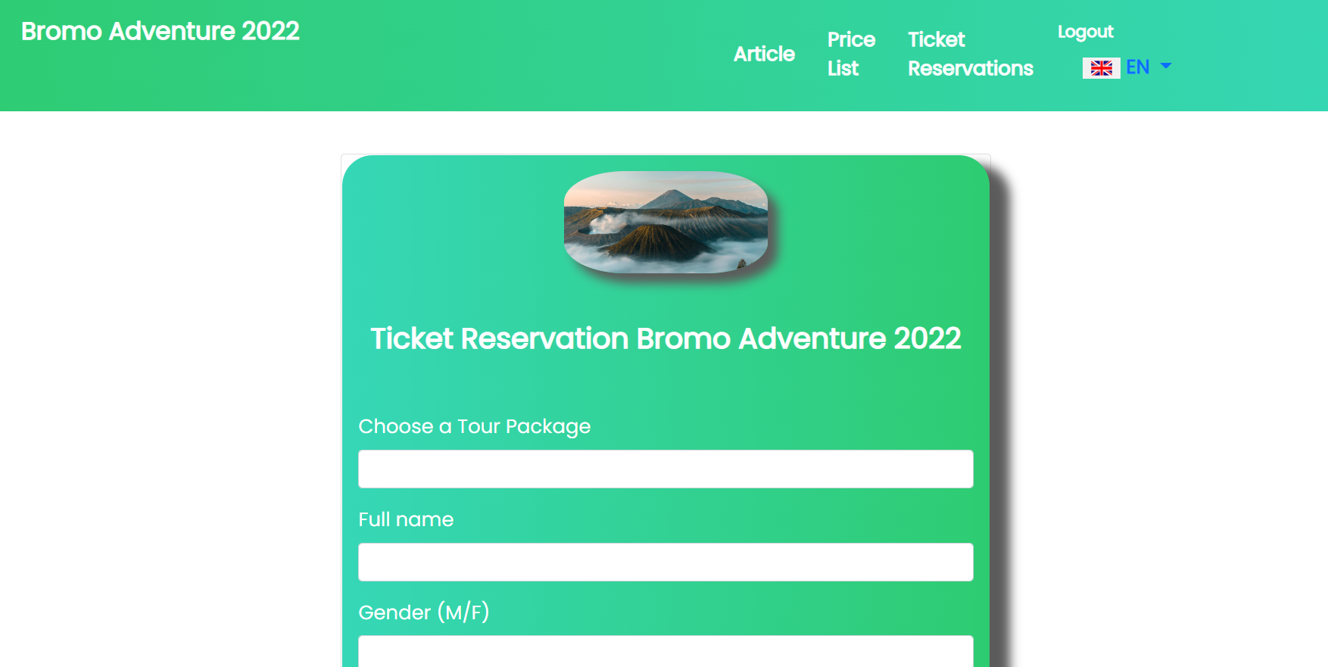
Penggunaan Localizations pada Ticket Reservation

Slide 13
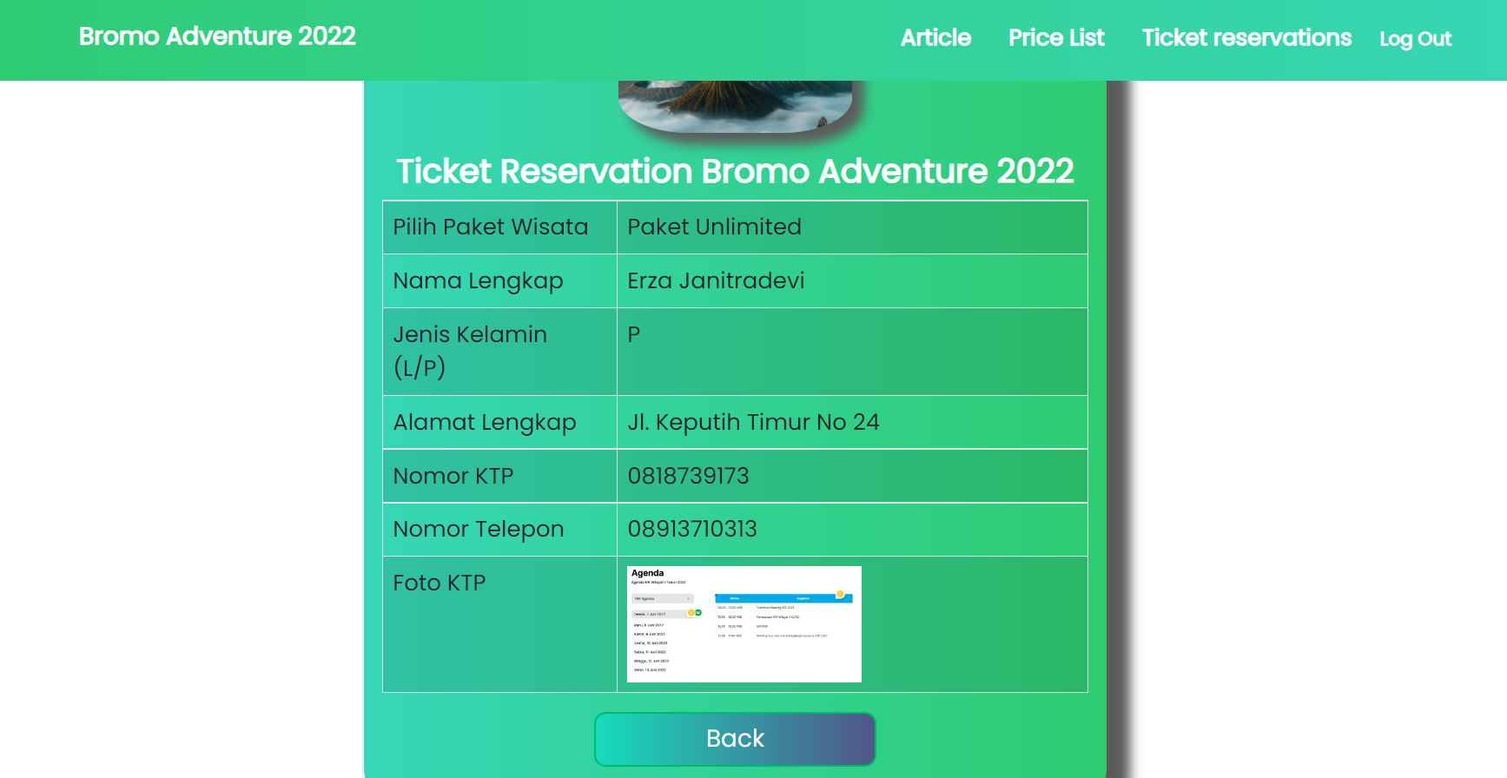
BUKTI PEMESANAN TIKET

Slide 14
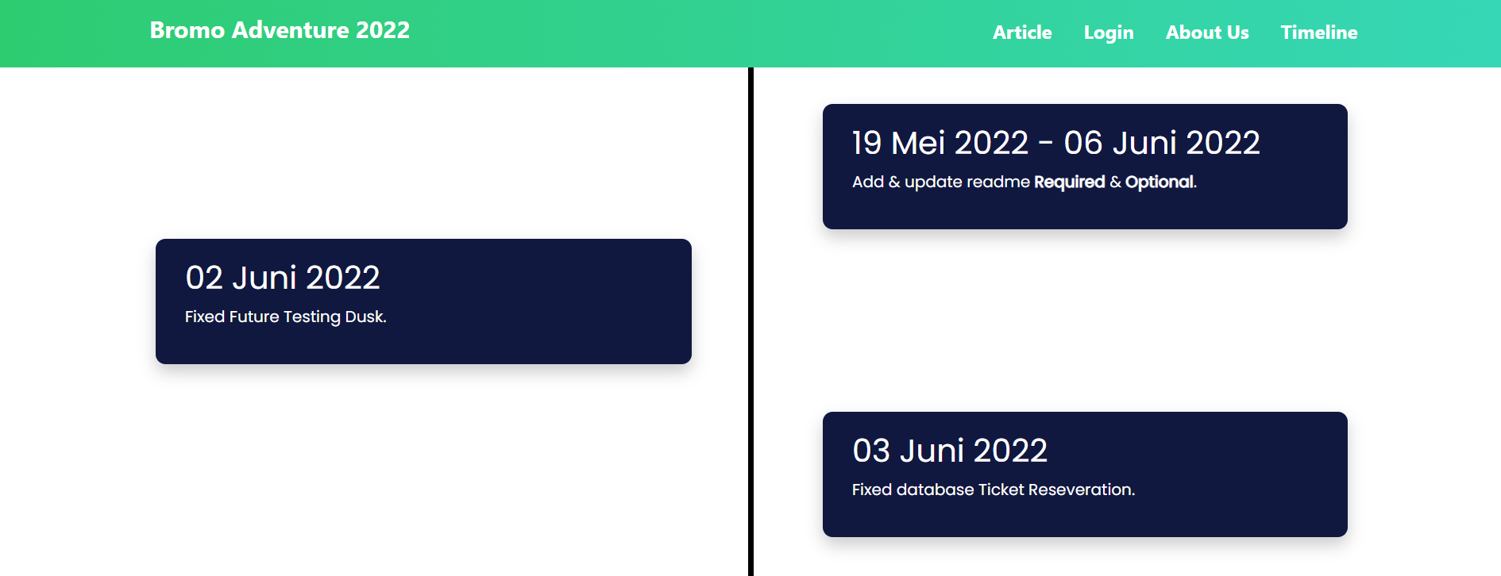
TIMELINE

Slide 15
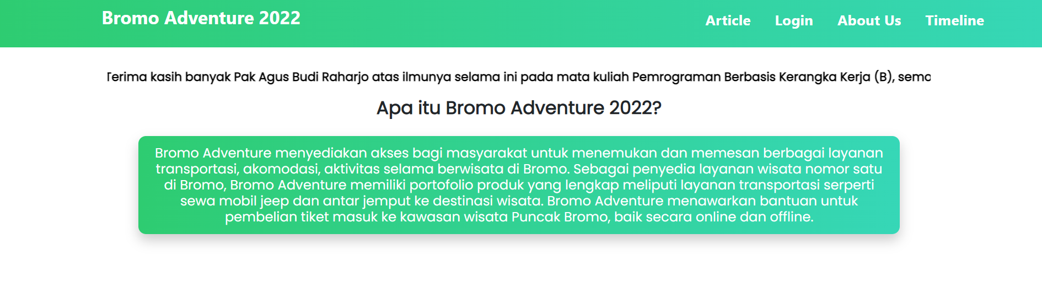
ABOUT US

Slide 16
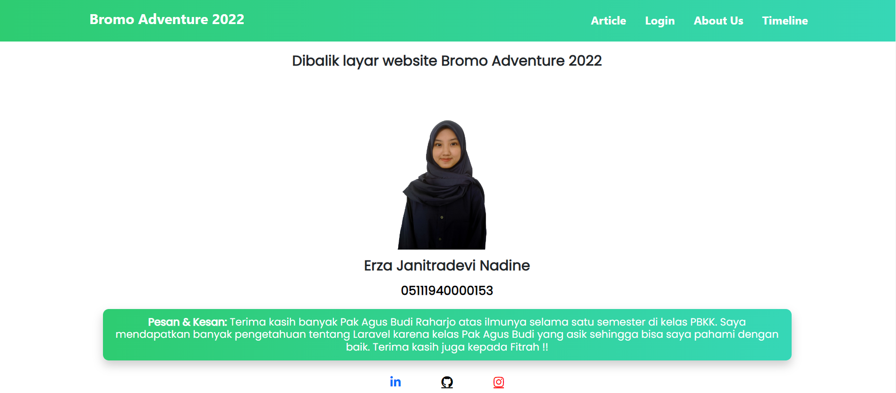
ABOUT US

Slide 17
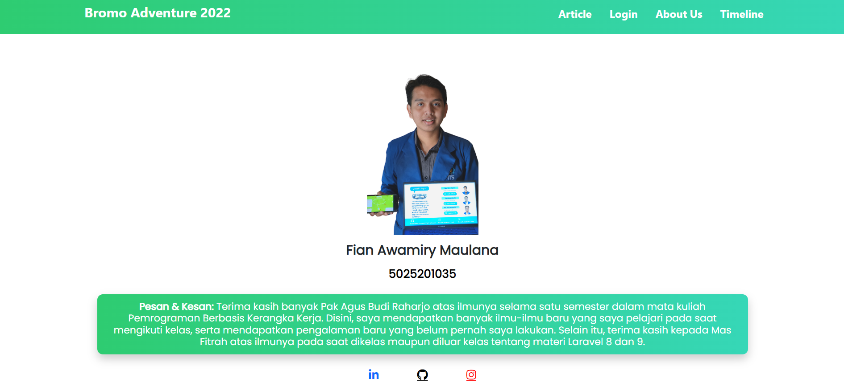
ABOUT US

Slide 18
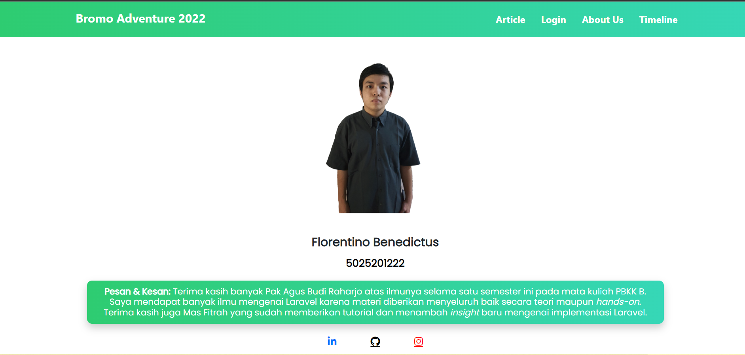
ABOUT US

Slide 19
02
DATABASE

Slide 20
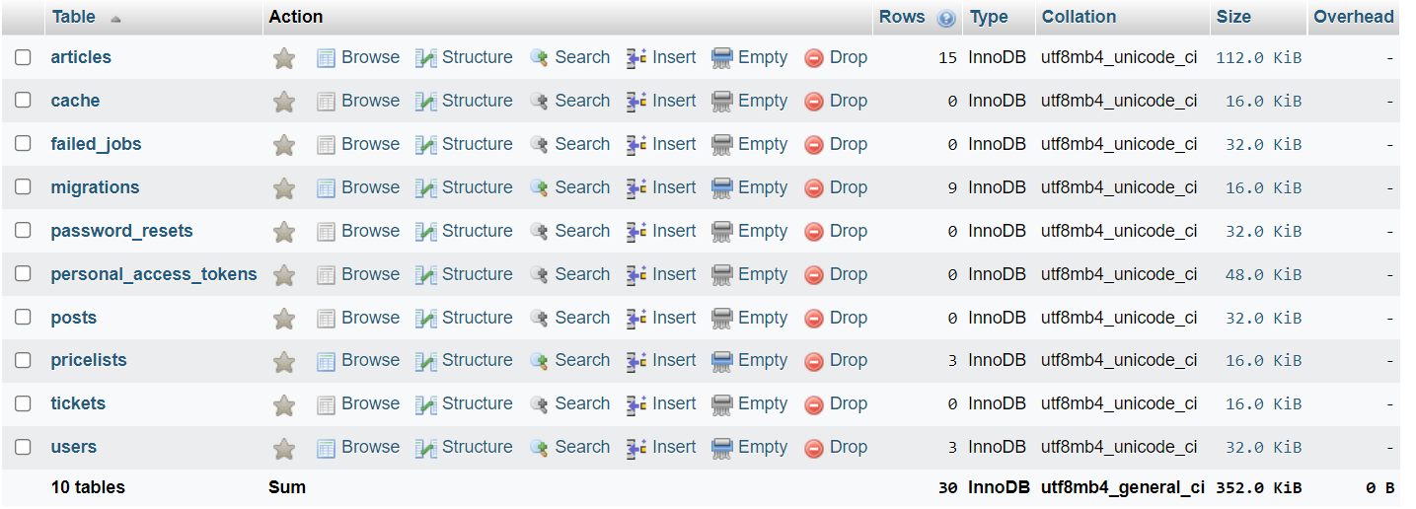
MIGRATIONS

Slide 21
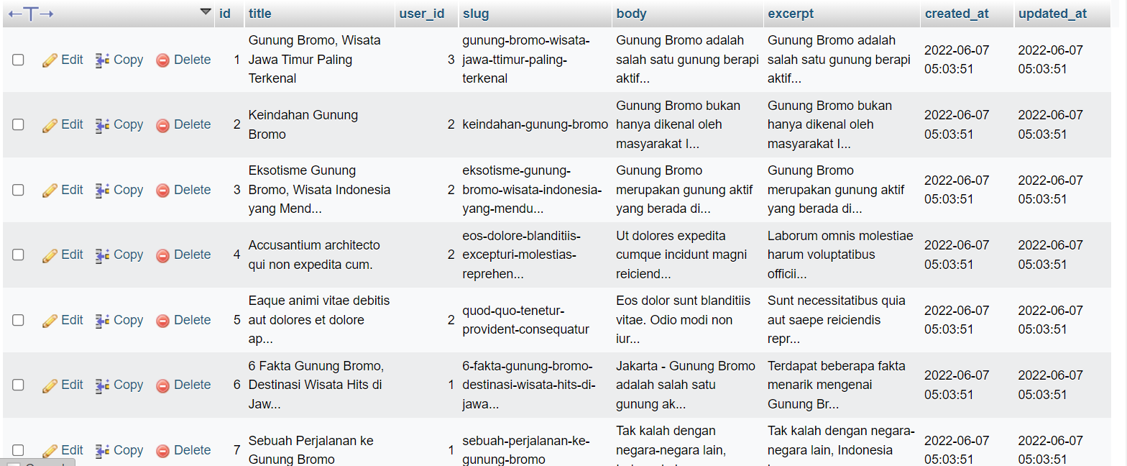
TABEL ARTICLES

Slide 22
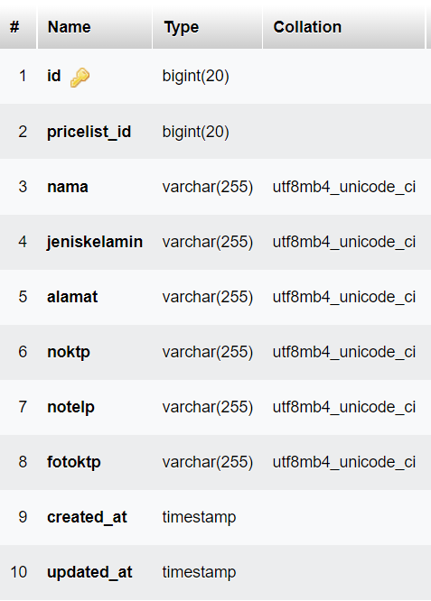
TABEL TICKETS

Slide 23
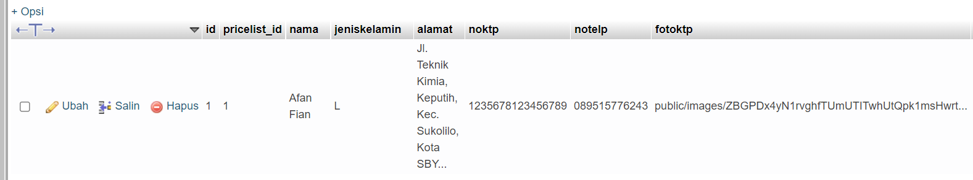
TABEL TICKET

Slide 24
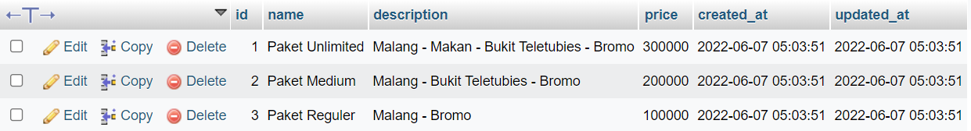
TABEL PRICE LIST

Slide 25
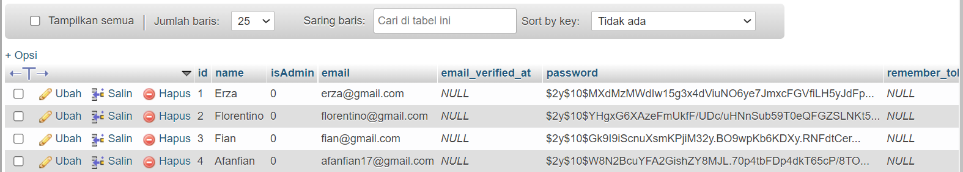
TABEL USER

Slide 26
02
TESTING

Slide 27
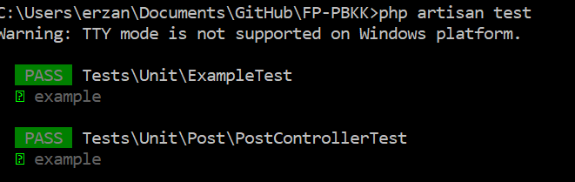
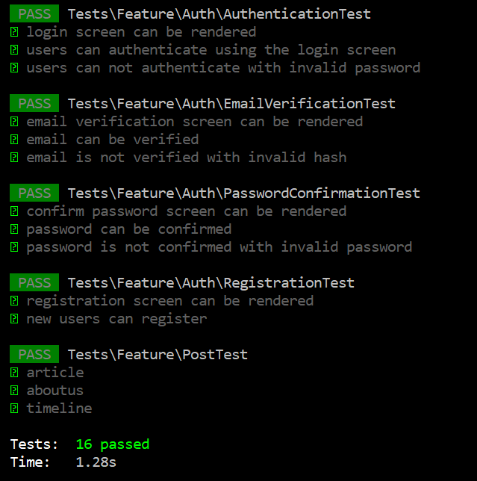
UNIT TESTING

Slide 28
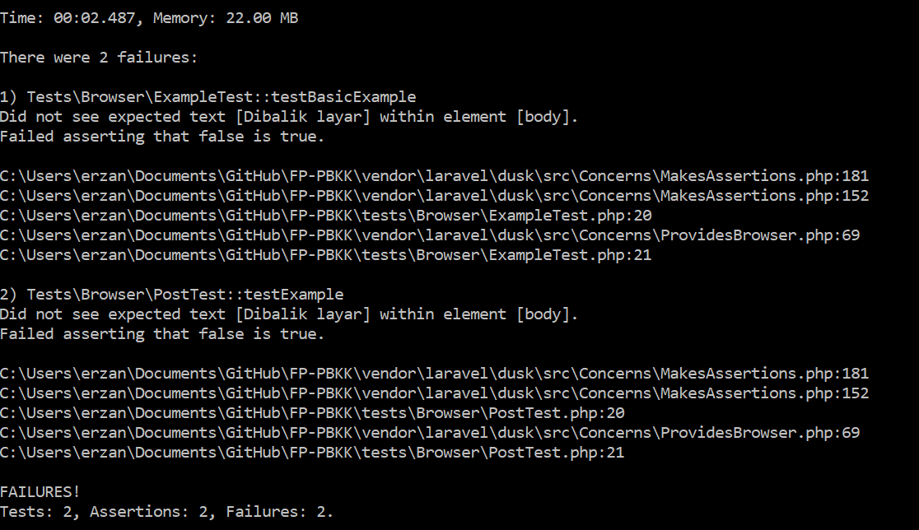
FEATURE TESTING

Slide 29
TERIMA KASIH

